Slide 1
Focal liver lesion
Faculty of surgery
Songkhla hospital

Slide 2
WORKUP ALGORYHM FOR LIVER MASS
Mass on scan
History of prior malignancy
No history of prior malignancy

Slide 3
History
Symptoms - abdominal pain/ pressure effect,fever,anoraxia,weight loss
Patient characteristics (age, gender, use of OCP, risk factors for chronic liver disease )
History or findings of extrahepatic malignancy

Slide 4
Physical examination and investigation
Sign of chronic liver stigmata or portal hypertention
Lymphadenopathy
CBC with PLT , coagulogram , LFT , hepatitis profile , tumor marker
Ultrasound , CT scan , MRI

Slide 5
Study show accurate preoperative evaluation of liver mass lesions without fine-needle biopsy about 98% by history and lab (including tumor markers) and a variety of imaging studies

Slide 6
Find needle biopsy
commonly used to assist in the diagnosis of a variety of liver lesions
Disadventage
  Increase risk of bleeding and seeding of neoplastic cells
  Some type liver lesion cannot diagnosis such as hepatic adenomas and focal nodular hyperplasia

Slide 7
Malignancy
Metastatic liver tumors
HCC
Cholangiocarcinoma
Rare tumor →hepatoblastoma , Germ cell tumor , Angiosarcoma , non-Hodgkin lymphoma

Slide 8
Metastatic liver tumors
Most common metastasis malignant hepatic neoplasm
The most common primaries :
breast, lung, colon
History or findings of extrahepatic malignancy menifestation

Slide 9
U/S
  multiple and hypoechoic lesion with Hypoechoic rims and internal heterogeneity
CT
  Hypovascular or hypervascular mass depend on metastasis origin
MRI
  metastatic lesions appear as low signal areas on T1-weighted images and moderately high signal on T2-weighted images

Slide 10
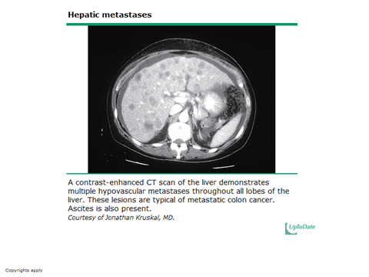

Slide 11
HCC
Most common primary malignancy liver tumor
Risk factors for chronic liver disease , viral hepatitis expect Hepatitis A ,metabolic liver diseases , expose hepatotoxin
Male : female > 4 : 1
Clinical : vary such as asymptomatic , abdominal pain , weight loss , paraneoplastic syndrome
Diagnosis : elevate AFP , CT scan

Slide 12
Investigation
U/S
  round or oval mass with sharp, smooth boundaries ,vary echogenicity
CT scan
  Vascular enhancement (ถูกเลี้ยงด้วย hepatic artery)
  Liver cirrhotic change , ascites , splenomegaly
  Non contrast phase : hypodense mass
  Contrast phase : arterial phase rapid vascular enhancement then venous phase hypodense

Slide 13
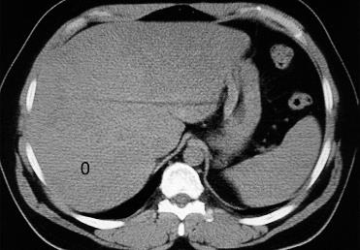
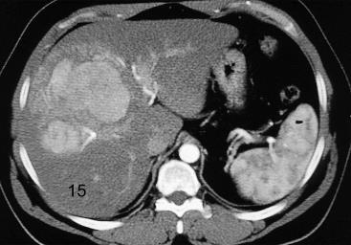
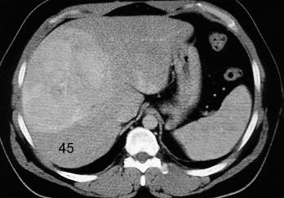
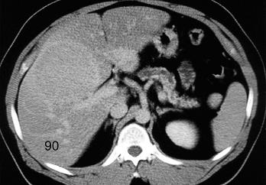
Hepatocellular carcinoma, CT of the liver before (a) and 15 sec (b), 45 sec (c) and 90 sec (d), respectively, following intravenous contrast medium administration

Slide 14
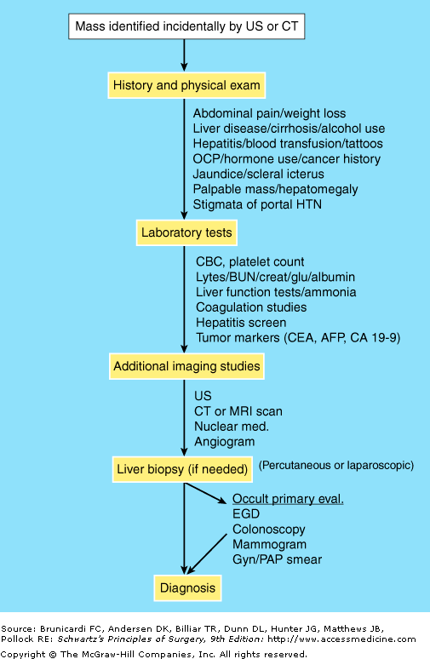

Slide 15
Fibrolamellar hepatocellular carcinoma (FCHC)
FHCC is a rare form of hepatocellular
Approximately 200 new cases are diagnosed worldwide each year.
FHCC often does not produce AFP
However, FHCC is elevated neurotensin levels.
FHCC generally occurs in young adults (~27yr.) without underlying cirrhosis.
FHCC grows slowly and has better prognosis,

Slide 16
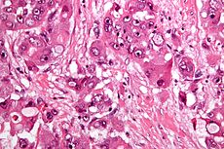
Fibrolamellar hepatocellular carcinoma (FCHC)
The histopathology of FHCC is characterized by laminated fibrous layers, interspersed between the tumor cells.
FHCC has a high resectability rate

Slide 17
Hepatoblastoma
most common liver cancer in children
most commonly diagnosed during a child's first three years of life
usually present with an abdominal mass
Patients with familial adenomatous polyposis (FAP) are risk factor
Often elevated AFP
Treatment : Surgical resection, adjuvant CMT, and liver transplantation

Slide 18
Germ cell tumor
Germ cell tumor is a neoplasm derived from germ cells.
can be cancerous or non-cancerous
Classification
  Germinomatous or seminomatous
  Non-germinomatous or non-seminomatous

Slide 19
Classification of
Germ cell tumor
Germinomatous - 10% have elevated hCG
  Disgerminoma
  Seminoma
Non-germinomatous
  Embryonal carcinoma
  yolk sac tumor - 100% secrete AFP
  Choriocarcinoma - 100% secrete hCG
  Teratoma
  Polyembryoma
  Gonadoblastoma
Mixed

Slide 20
Germ cell tumor
Compared to germinomatous tumors, nongerminomatous tumors tend to
  grow faster
  earlier mean age at time of diagnosis
  (~25 vs 35 years)
  lower 5 year survival rate
The survival rate for germinomatous tumors is higher because these tumors are very sensitive to radiation and CMT

Slide 21
Treatment of GCT
Women with benign germ cell tumors such as dermoid cysts are cured by ovarian cystectomy or oophorectomy
In general, all patients with malignant germ cell tumors will have the same staging surgery that is done for epithelial ovarian cancer.
If the patient is still interested in having children, an alternative is unilateral salpingoophorectomy, while the uterus, the ovary, and the fallopian tube on the opposite side can be left behind.

Slide 22
Treatment of GCT
Most patients with germ cell cancer will need to be treated with combination CMT for at least 3 cycles.
The CMT regimen most commonly used in germ cell tumors is called PEB (or BEP) and consists of bleomycin, etoposide, a platinum-based antineoplastic (cisplatin)

Slide 23
Cholangiocarcinoma
It has an annual incidence rate of 1–2 cases per 100,000 in the Western world
rates of cholangiocarcinoma have been rising worldwide over the past several decades.

Slide 24
Cholangiocarcinoma
It may be suspected in a patient with obstructive jaundice.
CT scanning is an important role in the diagnosis of cholangiocarcinoma.
may be challenging in patients with primary sclerosing cholangitis (PSC)
ERCP advantages include the ability to obtain biopsies and to place stents or perform other interventions to relieve biliary obstruction.

Slide 25
ควรมีเนื้อหาของ hepatoblastoma and Fibrolamellar variant of HCC อย่างละ 1 slide
Germ cell tumor ต้องรักษาอย่างไรต่อ(CMT)
เอา slide malignant ขึ้นก่อนนะ เพราะเกี่ยวกับเคสนี้

Slide 26
Benign

Slide 27
Benign
Hemangiomas
Focal nodular hyperplasia
hepatic adenomas
Simple cysts

Slide 28
Hemangiomas
Most common benign liver tumors
Female : male > 3 : 1
Most are asymptomatic and no malignant transformation
Large hemangiomas can cause symptoms as a result of compression of adjacent organs or intermittent thrombosis
Surgery may be considered an option if the patient is symptomatic
Gross : round pink or red capsule

Slide 29
Hemangiomas
U/S
  echogenic spot, well demarcated
CT scan
  Early phase พบ hypodense peripheral enhancement
  Delay phase พบ contrast fillling mass ทั่วๆ
MRI
  High sens and spec , high acurracy
  Hyperdense in T2 and blood fill space

Slide 30
Peripheral nodular enhancement follow by gradual centripetal enhancement

Slide 31
Focal nodular hyperplasia
Most commonly in women and asymptomatic
No malignant transformation
Gross : subcapsular lesion and central scar
Surgery indicate in symptomatic patient

Slide 32
Focal nodular hyperplasia
U/S
  Nodule with varying echogenicity
CT scan
  Non contrast phase พบ low density mass
  contrast phase พบ rapid enhance and wash out with central scar
MRI
  Hyperdense and central scar

Slide 33
Homogeneous
Isoattenuation
Immediate
Intense enhancement
Central scar 2/3

Slide 34
FNH & Hemangioma
Symptomatic : Surgery
** ไม่มีอาการไม่ต้องรักษา**

Slide 35
Hepatic Adenomas
Benign epithelial liver tumor that usually occurs in non-cirrhotic liver
most commonly seen in premenopausal women older than 30 years of age and relate with oral contraceptives use
About 50 % abdominal pain and 30 % bleeding
Risk of malignant transformation 10%
Surgery indicate in mass > 4 cm , no decrease size when stop pill

Slide 36
hepatic adenomas
U/S
  often large and in the right lobe of the liver and hyperechoic lesion
CT scan
  Non-contrast scan
    well-demarcated low density mass
  Contrast-enhanced scans
    Rapid enhance and wash out same FNH
    No central scar difference from FNH

Slide 37
HA

Slide 38
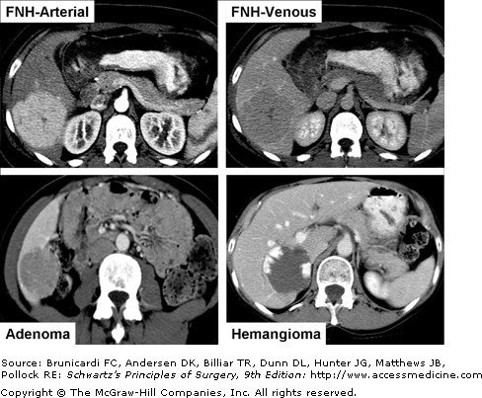

Slide 39
Thank you

